Slide 1
UM0016 Komunikasi Bisnis
Lanjutan Professionalism at Work: Business
Etiquette, Ethics, Teamwork, and Meetings

Slide 2

Using Voice Mail Professionally
On the
Receiver’s
End
On the
Caller’s
End

Slide 3
On the Receiver’s End
Don't overuse voice mail.
Set the number of rings appropriately.
Prepare a professional, concise, friendly greeting. Example: Hi! This is Jackie Young of PMP Associates, and I appreciate your call. You have reached my voice mailbox because I'm either working with clients or on another line at the moment. Please leave your name, number, and reason for calling so that I can be prepared when I return your call.

Slide 4

On the Receiver’s End
Test your message.
Change your message as necessary.
Respond to messages promptly.
Plan for vacations and other absences.

Slide 5
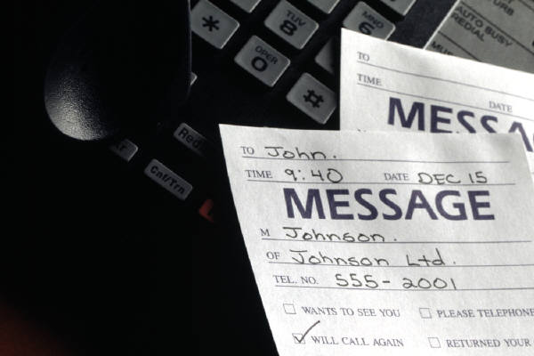
On the Caller’s End
Be prepared to leave a concise, complete message.
Use a professional, courteous tone.
Speak slowly; articulate your words.
Be careful with confidential information.
Don't make assumptions.

Slide 6

Professional Groups and Teams
Why Businesses Form Teams
Better decisions
Faster response
Increased productivity
Greater buy-in
Less resistance to change
Improved employee morale
Reduced risks

Slide 7
Becoming a Valued Team Player
Negative Team Behaviors
Blocking ideas and suggestions of others
Insulting and criticizing others
Wasting the group’s time
Making inappropriate jokes and comments
Failing to stay on task
Withdrawing, failing to participate

Slide 8

Becoming a Valued Team Player
Positive Team Behaviors
Setting rules and abiding by them
Analyzing tasks and defining problems
Contributing information and ideas
Showing interest by listening actively
Helping to resolve differences
Synthesizing points of agreement

Slide 9

Characteristics: Successful Teams
Small size, diverse makeup
Agreement on purpose
Agreement on procedures
Ability to confront conflict

Slide 10
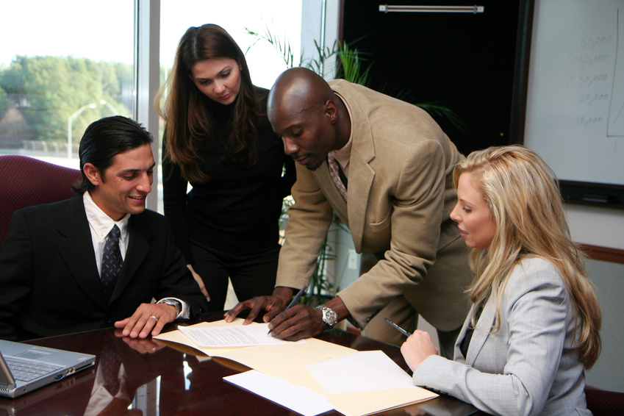
Characteristics: Successful Teams
Use of good communication techniques
Ability to collaborate rather than compete
Shared leadership
Acceptance of ethical responsibilities

Slide 11
Productive Business Meetings
Before
the
meeting
During
the
meeting
Ending the
meeting and
following up

Slide 12
Productive Business Meetings
Before
During
Ending and
following up
Determine your purpose.
Decide how and where to meet.
Organize an agenda:
Date and place
Start and end times
Topics
People responsible
Time for each topic
Meeting preparation

Slide 13
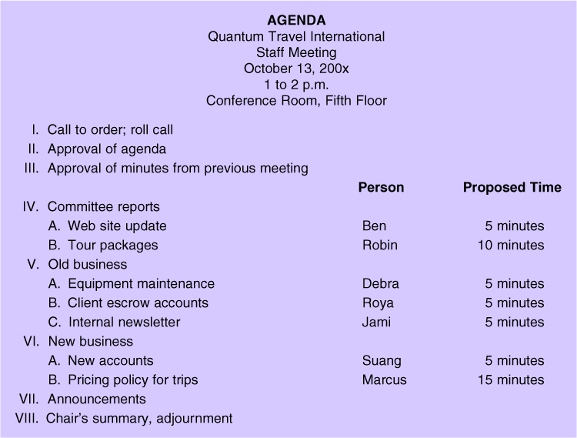
Typical Meeting Agenda

Slide 14

Productive Business Meetings
Before
During
Ending and
following up
Invite participants.
Prepare the meeting location and materials.

Slide 15
Productive Business Meetings
Before
During
Ending and
following up
Start the meeting on time.
Introduce the meeting:
Meeting goals
Meeting length
Background
Possible solutions
Tentative agenda
Ground rules

Slide 16

Sample Ground Rules
Arrive on time.
Communicate openly.
Be supportive and keep an open mind.
Listen carefully and participate fully.
Don’t monopolize.

Slide 17

Sample Ground Rules
Confront conflict frankly.
Refrain from personal attacks or put-downs.
Follow the agenda.
Turn off cell phones.
Follow parliamentary procedure.

Slide 18
Productive Business Meetings
Before
During
Ending and
following up
Move the meeting along.
Encourage all to participate.
Discourage monopolizers.
Avoid digressions.
When the group reaches consensus, summarize and ask for confirmation.

Slide 19
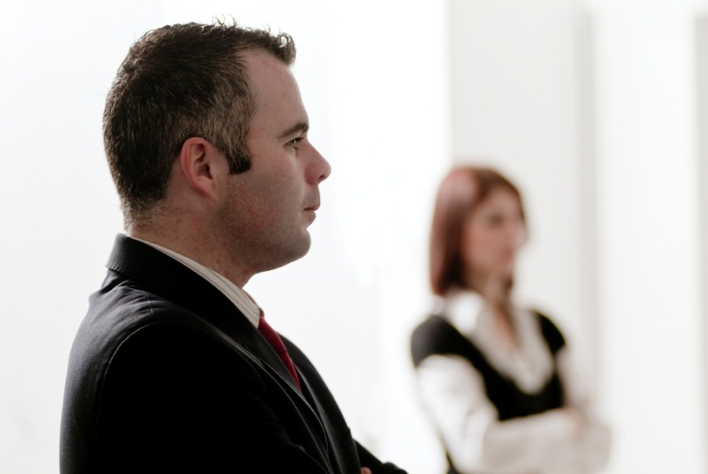
Productive Business Meetings
Before
During
Ending and
following up
If conflict develops, encourage each person to speak and let groups decide on a direction to follow.
Control dysfunctional group members.

Slide 20
Controlling Dysfunctional Members
Before
During
Ending and
following up
Lay down rules
Seat potentially dysfunctional members strategically
Avoid direct eye contact
Assign dysfunctional members specific tasks
Give praise and encouragement.

Slide 21

Productive Business Meetings
Before
During
Ending and
following up
Conclude the meeting at the agreed time.
Summarize decisions.
Review deadlines and responsibilities for action items.

Slide 22
Productive Business Meetings
Before
During
Ending and
following up
For small groups, try "once around the table."
Thank the group; establish a time for the next meeting.
Return the room to a neat appearance; vacate promptly.

Slide 23

Productive Business Meetings
Before
During
Ending and
following up
Distribute minutes.
Check to see that all assigned tasks are completed by agreed-upon deadlines.

Slide 24
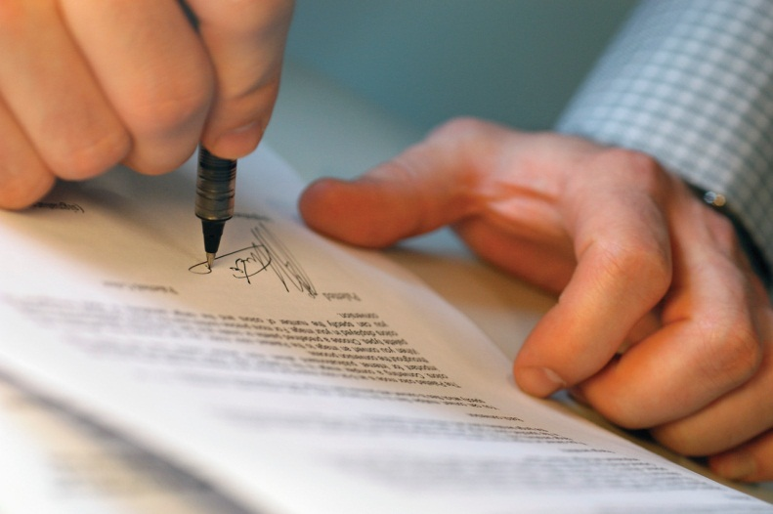
Meeting Minutes
Meeting minutes may include the following:
Date, time, location of meeting
List of participants and absentees
Details about each agenda item (main discussion points, outcomes, assignments, etc.)
Items to discuss at future meetings

Slide 25

“Teamwork divides the task and multiplies the success.”
--Author unknown

Slide 26
Question & Answers

